Slide 1

APPLICATION FOR DIGITAL AMBULANCE SERVICES
DIGITAL AMBULANCE SERVICE APP

Slide 2
Content:
An emergency is a situation that poses an immediate risk to health, life, property, or environment.
Most emergencies require urgent intervention to prevent a worsening of the situation, although in some situations, mitigation may not be possible and agencies may only be able to offer palliative care for the aftermath.
The precise definition of an emergency, the agencies involved and the procedures used, vary by jurisdiction, and this is usually set by the government.
While some emergencies are self-evident (such as a natural disaster that threatens many lives), many smaller incidents require that an observer (or affected party) decide whether it qualifies as an emergency.
whose agencies (emergency services) are responsible for emergency planning and management.
An ambulance is a medically equipped vehicle which transports patients to treatment facilities, such as hospitals.

Slide 3
Product features & product prespective:
This product provides ambulance services to the users in emergency condition. In very serious case the software automatically selects the nearest located hospital from where the ambulance will come. Or user can even select the hospital from where user want an ambulance. This product only provides the ambulance services from respective hospitals in users locality
This product is a new, self-contained product based on the present emergency condition of our society. It will help users to get ambulance services in any emergency condition. People will not have to call and wait for ambulance. Using this product users can track the ambulance

Slide 4
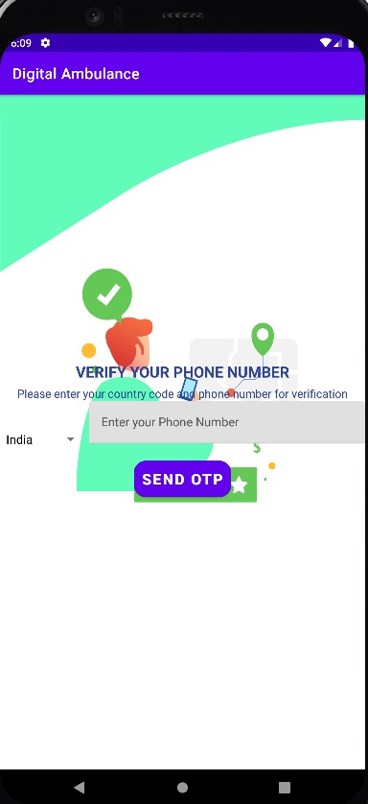
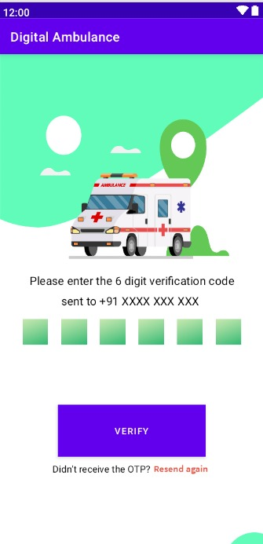
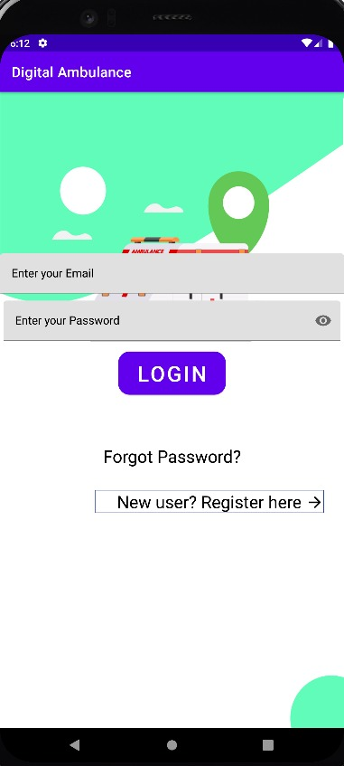
Screen shots for user application:

Slide 5
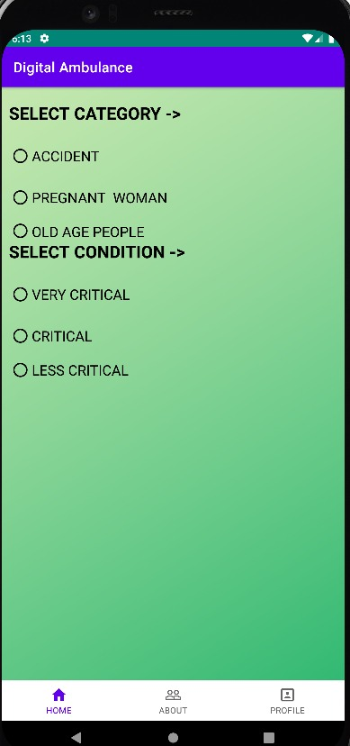
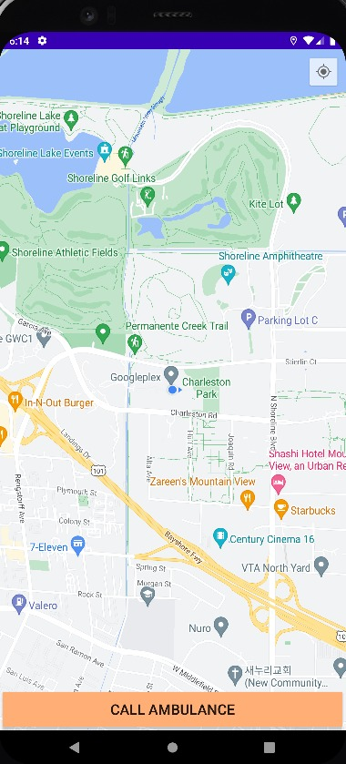
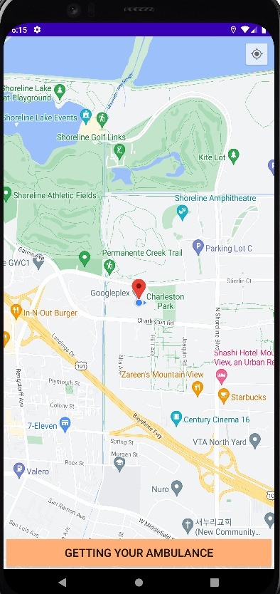
Screen shots of Map:

Slide 6
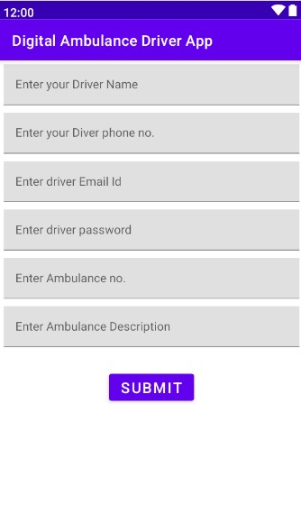
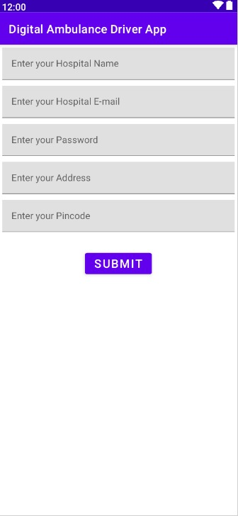
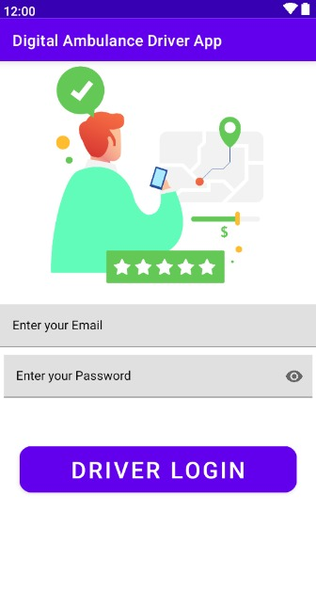
Screen shots for Driver application:

Slide 7
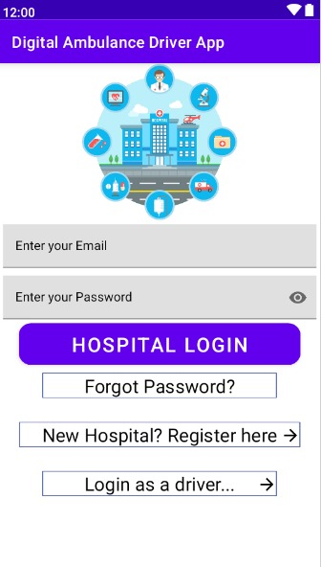
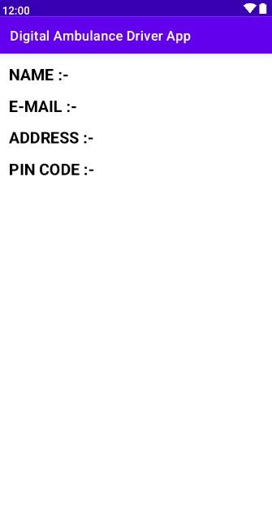
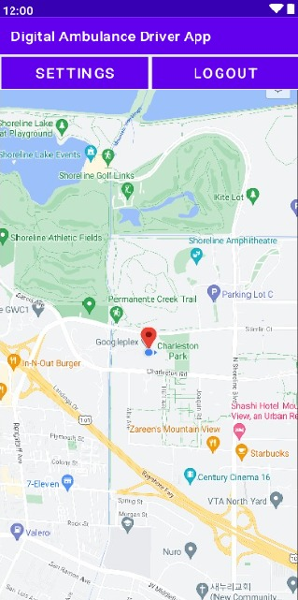
Screen shots:

Slide 8
SHYAM M V JACOB JABAKUMAR S SURYA J JOTHILINGAM S NITHISH KUMAR M
Submitted by :

Slide 9
THANK YOU

